Slide 1
Data Analytics
Atul Kahate

Slide 2
Basic Concepts

Slide 3
Current and Historical Data
Credit Card Transaction
Credit Card Transaction
Credit Card Transaction
Historical data of Credit Card Transactions
Credit Card Transaction
Credit Card Transaction
Credit Card Transaction
Credit Card Transaction

Slide 4

Using Data
Valid transaction?
Invalid transaction?
Amount range: 1-5000
Time: Morning
City: Pune
Reason: Shopping
Amount range: 5001-10000
Time: Afternoon
City: Mumbai
Reason: Hotel
Clusters
Amount range: 10000-25000
Time: Evening
City: Delhi
Reason: Bill Pymt
Amount range > 25001
Time: Night
City: Other
Reason: Online

Slide 5
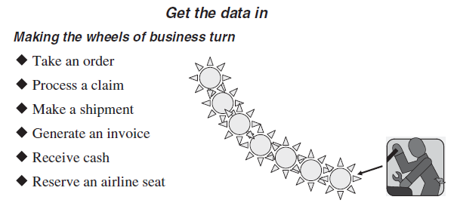
Operational and Analytical Systems

Slide 6
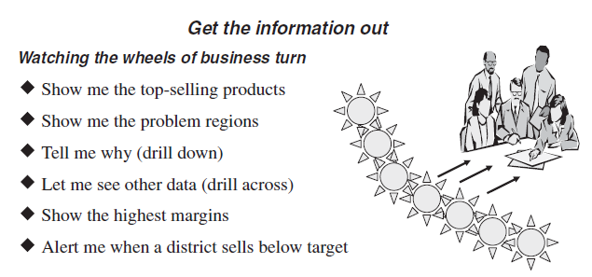
Operational and Analytical Systems

Slide 7
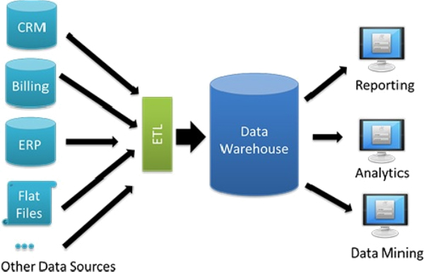
Data Warehousing to Data Analytics

Slide 8
Areas of Data-related Work

Slide 9
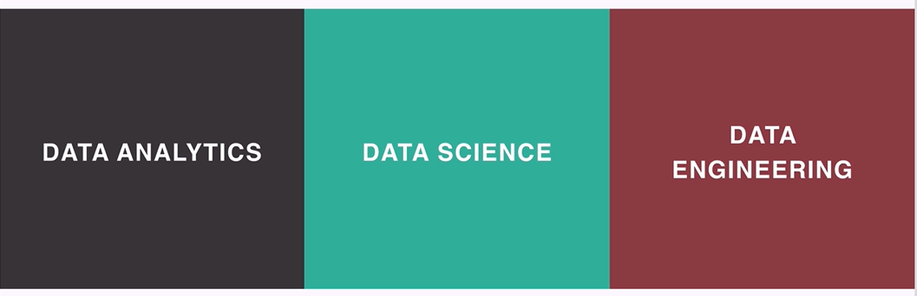
Three Key Parts

Slide 10
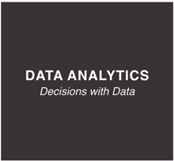
Data Analytics

Slide 11
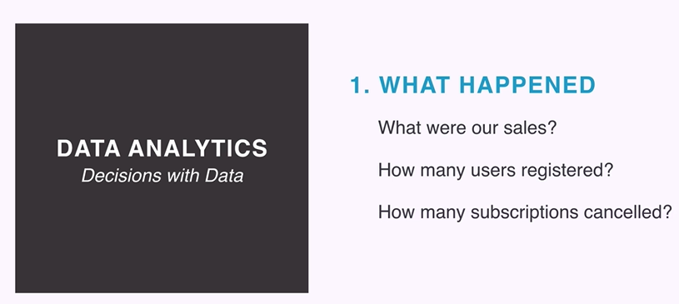
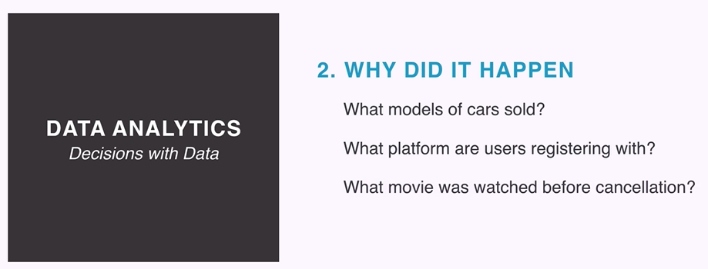
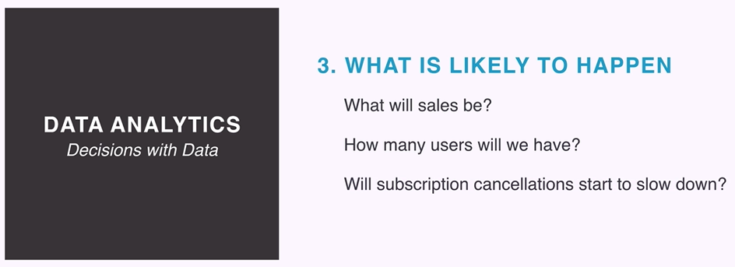
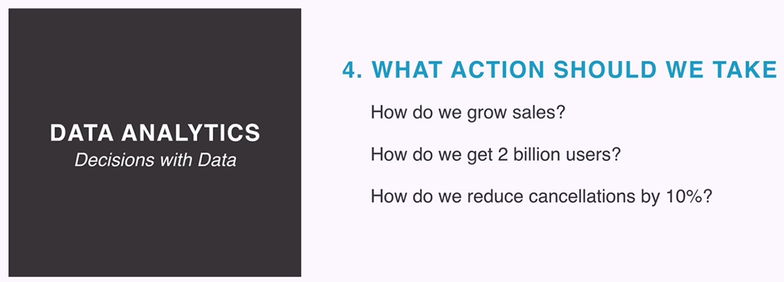
Data Analytics

Slide 12
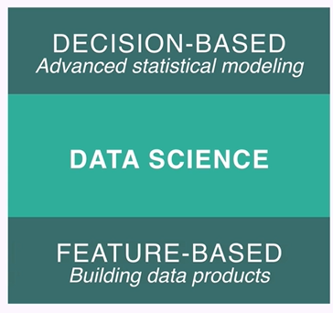
Data Science

Slide 13


Data Science Examples

Slide 14

Data Engineering

Slide 15
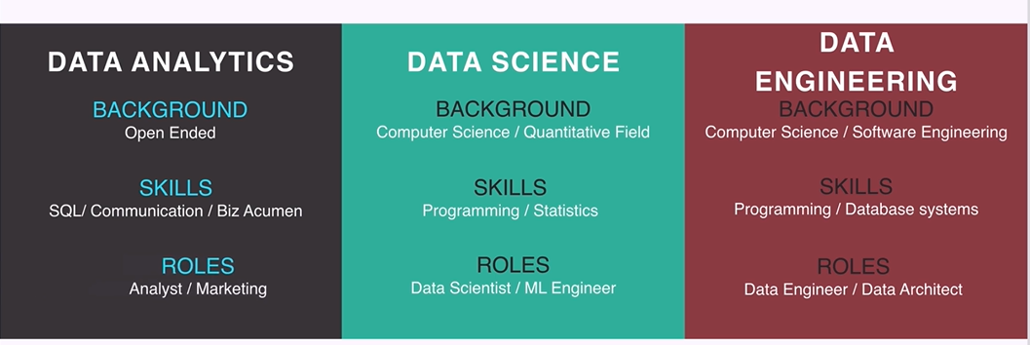
Data Roles

Slide 16
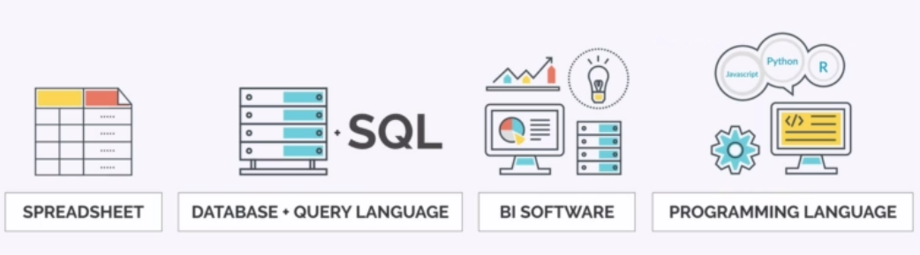
Data Analytics Tool Categories

Slide 17
Data Analytics Life Cycle

Slide 18
Data Analytics Life Cycle
Business/Data analytics, or simply analytics is the use of data, information technology, statistical analysis, quantitative methods, and mathematical or computer-based models to help managers gain improved insight about their business operations and make better, fact based decisions

Slide 19
Types of Business Analytics
Optimization, Decision trees
Descriptive analytics (Hindsight)
Diagnostic analytics
Predictive analytics (Insight)
Prescriptive analytics (Foresight)
Prescriptive Analytics
What is the best action?
Predictive Analytics
What will happen in the future?
Diagnostic Analytics
Why did it happen?
Forecasting, Data mining, Regression, Simulations
Descriptive Analytics
What happened in the past?
Dashboards, Business intelligence

Slide 20
Descriptive Analytics
The use of data to understand past and current business performance and make informed decisions
Examples
Customer basket analysis – Shopping patterns, Associations between products using Apriori algorithm
Movie review sentiment analysis

Slide 21
Diagnostic Analytics
Why something happened?
Examples
Credit card fraud detection using classification
Compare performance of two ML models (A/B Testing)

Slide 22
Predictive Analytics
Predict the future by examining historical data, detecting patterns or relationships in these data, and then extrapolating these relationships forward in time.
Examples:
Predict whether a customer will churn at HDFC Bank
Predict next year sale for Walmart

Slide 23
Prescriptive Analytics
Uses optimization to identify the best alternatives to minimize or maximize some objective.
Examples:
From a million songs on YouTube, predict the song(s) that an individual will like
Analyze historical sale data, customer behavior, market trends etc to recommend the price level for a soap manufactured by HLL

Slide 24
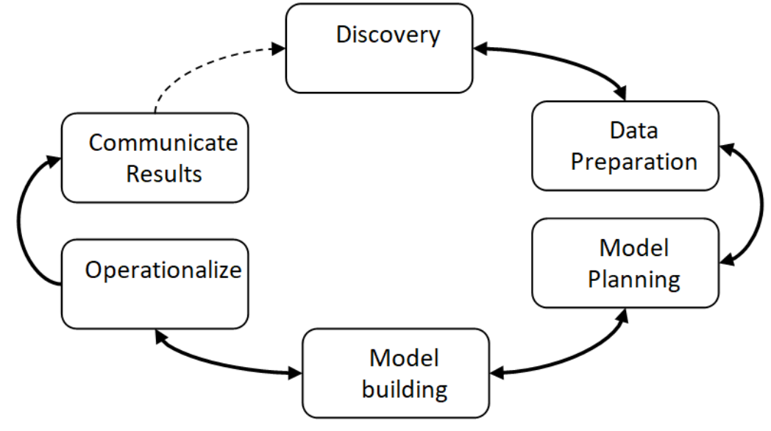
Data Analytics Life Cycle
Data Analytics Lifecycle defines the roadmap of how data is generated, collected, processed, used, and analyzed to achieve business goals.

Slide 25
Phase 1: Data Discovery and Formation
This phase is all about defining the data’s purpose and how to achieve it by the end of the data analytics lifecycle. The stage consists of identifying critical objectives a business is trying to discover by mapping out the data. During this process, the team learns about the business domain and checks whether the business unit or organization has worked on similar projects to refer to any learnings.
In this phase, the team also evaluates technology, people, data, and time. For example, while dealing with a small dataset, the team can use Excel. However, complex tasks demand more rigid tools for data preparation and exploration. In such scenarios, the team will need to use Python, R, Tableau Desktop or Tableau Prep, and other data cleaning tools.
This phase’s critical activities include framing the business problem, formulating initial hypotheses to test, and beginning data learning.

Slide 26
Phase 2: Data Preparation and Processing
In this phase, the experts’ focus shifts from business requirements to information requirements. One of the essential aspects of this phase is ensuring data availability for processing. The stage encompasses the collection, processing, and cleansing of the accumulated data.
During this phase’s initial stage, the team gathers valuable information and proceeds with the business ecosystem’s lifecycle. Various data collection methods are used for this purpose, such as:
Data Entry – Collecting recent data using manual data entry techniques or digital systems within the organization
Data Acquisition – Gathering data from external sources
Signal Reception – Capturing data from digital devices, including the Internet of Things and control systems

Slide 27
Phase 3: Design a Model
The team can load data in several ways:
Extract, Transform, Load (ETL) – It transforms the data based on a set of business rules before loading it.
Extract, Load, Transform (ELT) – It loads the data and then transforms it based on a set of business rules.
Extract, Transform, Load, Transform (ETLT) – It’s the combination of ETL and ELT and has two transformation levels.
The team identifies variables for categorizing data, identifies and removes data errors. Data errors can be anything, including missing data, illogical values, duplicates, and spelling errors. For example, the team imputes the average data score for categories for missing values. It enables more efficient data processing without skewing the data.
After cleaning the data, the team determines the techniques, methods, and workflow for building a model in the next phase.

Slide 28
Phase 4: Model Building
In this phase, the team develops testing, training, and production datasets.
Further, the team builds and executes models meticulously as planned during the model planning phase.
They test data and try to find out answers to the given objectives.
They use various statistical modeling methods such as regression techniques, decision trees, random forest modeling, and neural networks and perform a trial run to determine whether it corresponds to the datasets.

Slide 29
Phase 5: Result Communication and Publication
This phase aims to determine whether the project results are a success or failure and start collaborating with significant stakeholders.
The team identifies the vital findings of their analysis, measures the associated business value, and creates a summarized narrative to convey the stakeholders’ results.

Slide 30
Phase 6: Measuring the Effectiveness
In this final phase, the team presents an in-depth report with coding, briefing, key findings, and technical documents and papers to the stakeholders.
Besides this, the data is moved to a live environment and monitored to measure the analysis’s effectiveness.
If the findings are in line with the objective, the results and reports are finalized.
On the other hand, if they deviate from the set intent, the team moves backward in the lifecycle to any previous phase to change the input and get a different outcome.

Slide 31
Basic Concepts

Slide 32
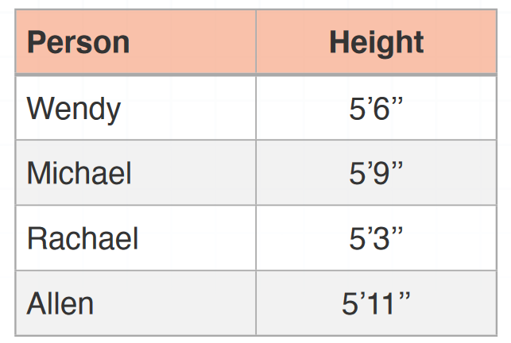
Individuals and Variables
Individuals are items in a data set and can be cases, things, people, etc.
They have one or more properties, called as variables.
Heights are a variable because height is a property of each individual
Individuals are the people

Slide 33
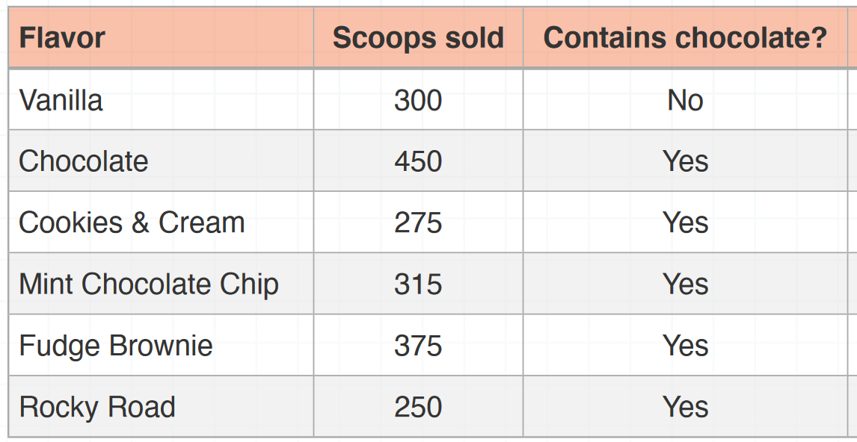
Data and Data Table
Together, individuals and variables are called data.
When we organize data into a table like this one, we call it a data table.
Here’s an example of a data table about ice cream:

Slide 34
Variable Types
Variables can be categorical or quantitative.
In the table for “heights of people in the car,” there’s one quantitative variable: the height.
In the table for “ice cream shop data for July,” there’s one quantitative variable (scoops), and one categorical variable (contains chocolate).
Categorical variables are non-numerical variables. Categorical variables are also called “qualitative” variables. Their values aren’t represented with numbers.
Quantitative variables are numerical variables. Their values are numbers.

Slide 35
Quantitative Variable Sub-types
Discrete variables are those quantitative variables that we can obtain by counting. Therefore, they can take on only certain numerical values. For example, the number of scoops of ice cream sold is a discrete quantitative variable, because we can’t really sell 8.3 or 5.23 scoops of ice cream.
Continuous variables may include data as decimals, fractions, or irrational numbers. For example, the height of the people is a continuous variable.

Slide 36
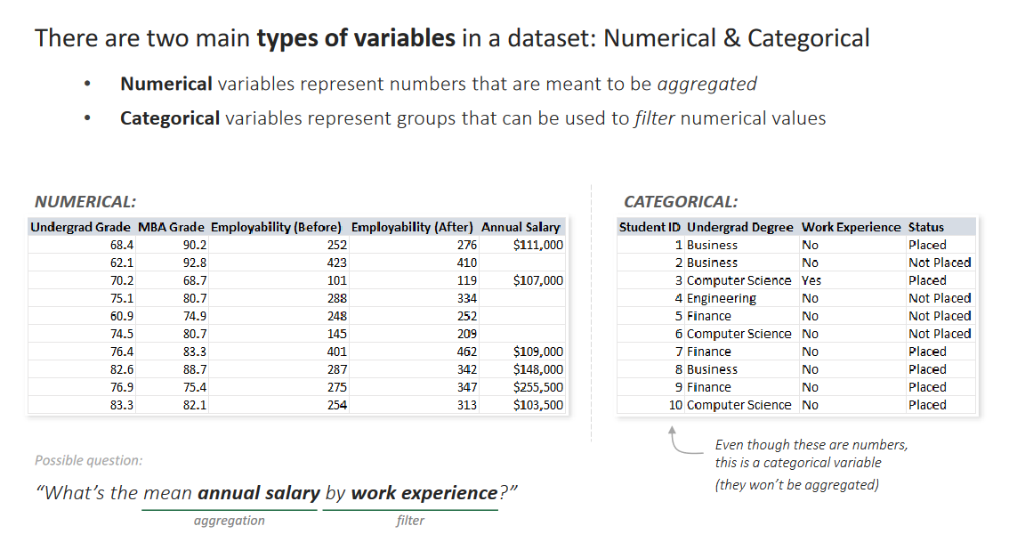
Types of Variables

Slide 37
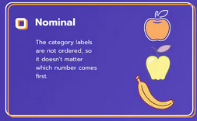
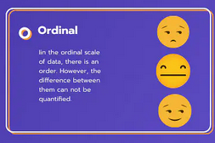
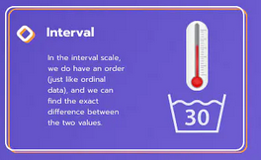
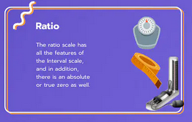
Four Levels of Measurement
Nominal
Ordinal
Interval
Ratio

Slide 38
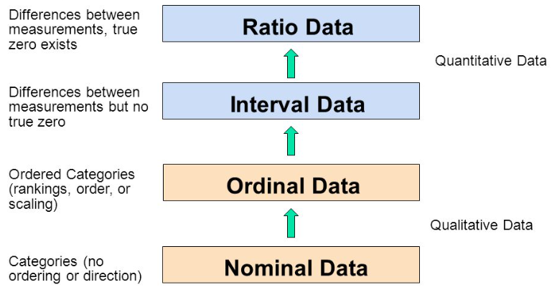
Types of Data

Slide 39
Nominal Data
Nominal data refers to data that can be classified into categories or groups, but that do not have any inherent order or ranking
Nominal data is the simplest form of data and is often used to describe qualitative variables
Examples:
Gender (Male/Female)
Marital Status (Single/Married/Divorced)
Eye Color (Brown/Blue/Green)
Ethnicity (Caucasian/African-American/Asian/Latino)

Slide 40
Nominal Data
Nominal data is different from ordinal data, which involves data that can be ranked or ordered, such as "low, medium, high" or "1st, 2nd, 3rd”
Nominal data cannot be ordered or ranked in this way
Contingency tables, chi-square tests, and frequency distributions can be used to analyze nominal data.
Nominal data cannot be analyzed using certain statistical measures, such as mean or median, since there is no inherent order to the data
Instead, nominal data is typically analyzed using measures of frequency and proportion, such as percentages or ratios

Slide 41
Ordinal Data
Ordinal data refers to data that can be ranked or ordered based on their values
Ordinal data are used to describe variables that have a natural order or sequence but where the difference between the values is not necessarily the same
Examples
Educational attainment (e.g., high school, associate degree, bachelor's degree, master's degree)
Levels of agreement (e.g., strongly agree, agree, neutral, disagree, strongly disagree)
Ratings (e.g., poor, fair, good, very good, excellent)

Slide 42
Ordinal Data
Ordinal data is different from nominal data, which involves data that can be classified into categories or groups but do not have any inherent order or ranking
Ordinal data, on the other hand, have a natural order, and the difference between each value may not be constant
Ordinal data can be analyzed using methods that take into account the order or ranking of the data, such as median, mode, and percentile
Other methods of analysis include using contingency tables, chi-square tests, and Spearman's rank correlation coefficient
It is important to note that while ordinal data can be treated as numerical data in some cases, it is still considered a categorical variable and requires appropriate statistical methods and techniques for analysis

Slide 43
Interval Data
Interval data refers to data that have a numerical value or measurement and can be ranked or ordered
Interval data are used to describe variables where the difference between the values is meaningful, and equal intervals exist between values, but there is no true zero starting point, instead there is an arbitrary zero point
Examples
Temperature measured in degrees Celsius or Fahrenheit

Slide 44
Interval Data
Interval data is different from ordinal data, which involves data that can be ranked or ordered, but the difference between the values is not necessarily equal
For example, a rating of "good" may be one point away from "fair" in an ordinal scale, while a temperature of 10 degrees Celsius is equal to 50 degrees Fahrenheit in an interval scale
In statistical analysis, interval data can be treated as continuous numerical data and analyzed using a wide range of statistical techniques, including measures of central tendency (e.g., mean, median, mode), measures of variability (e.g., variance, standard deviation), and correlation coefficients (e.g., Pearson correlation coefficient)
It is important to note that interval data must be properly scaled and transformed to ensure that statistical methods can be applied appropriately
Additionally, when interpreting results, it is important to keep in mind that there is no true zero point in interval data

Slide 45
True Zero Concept
Interval data has an arbitrary zero starting point
Ratio data has a true zero starting point
Consider 0°C temperature: It is not the lowest, since it translates to 32°F; and we can have temperatures lower than that as well, e.g. -1°C … Arbitrary zero starting point -> Interval data … 0 does not really mean 0
Now consider marks obtained by students in an exam: 70, 0, 30, 56, 82: Here, we may have a student who really got zero marks and there cannot be any negative marks … True zero starting point -> Ratio data … 0 means 0

Slide 46
Ratio Data
Ratio data is a type of quantitative data that starts with a natural zero point (i.e. true zero) and can be measured on a continuous scale with equal intervals between values
Examples of ratio data include weight, height, distance
In addition, because ratio data is measured on a continuous scale with equal intervals, arithmetic operations such as addition, subtraction, multiplication, and division can be meaningfully applied to the data
This allows for more advanced statistical analyses, such as regression analysis and ANOVA
Examples of statistical techniques that can be used with ratio data include mean, median, mode, variance, standard deviation, correlation, regression analysis, and t-tests

Slide 47
Interval Data and Ratio Data – Key Differences
Because ratio data has a natural zero point, it is possible to use mathematical operations such as multiplication and division to create meaningful ratios between values
For instance, if one two students have got 80 and 40 marks respectively, the marks ratio can be meaningfully expressed as 2:1
This is not possible with interval data since a score of zero is not a true zero, and ratios between values are meaningless
For instance, 40°C does not mean twice as hot as 20°C

Slide 48
Visualization and Exploring Data

Slide 49
Data Visualization
“A picture is worth 1000 words”
Converting data into information to understand past and current performance is the core of descriptive analytics and is vital to making good business decisions.
Techniques for doing this range from plotting data on charts, extracting data from databases, and manipulating and summarizing data.
Data visualization is the process of displaying data (often in large quantities) in a meaningful fashion to provide insights that will support better decisions.

Slide 50
Data Visualization
Raw data are important, particularly when one needs to identify accurate values or compare individual numbers.
However, it is quite difficult to identify trends and patterns, find exceptions, or compare groups of data in tabular form.
The human brain does a surprisingly good job processing visual information—if presented in an effective way.
Visualizing data provides a way of communicating data at all levels of a business and can reveal surprising patterns and relationships.
See https://www.census.gov/dataviz/

Slide 51
One-way Tables

Slide 52
Bar Graphs and Pie Charts
Bar graphs and pie charts are two of the simplest ways to summarize and represent data.

Slide 53
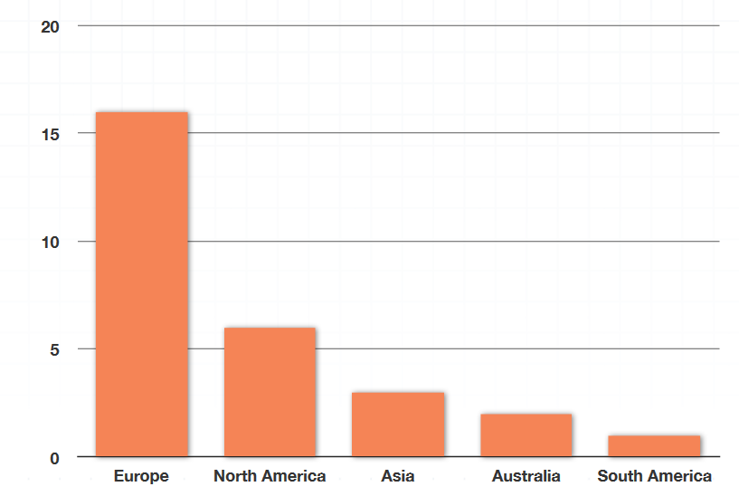
Bar Graph
In general, a bar graph, also called a bar chart, usually looks something like this:

Slide 54
Bar Graph in Excel
https://www.excel-easy.com/examples/bar-chart.html

Slide 55
barGraph-2.py
import numpy as np
import matplotlib.pyplot as plt
# creating the dataset
data = {'C':20, 'C++':15, 'Java':30,
'Python':35}
courses = list(data.keys())
values = list(data.values())
fig = plt.figure(figsize = (10, 5))
# creating the bar plot
plt.bar(courses, values, color ='maroon',
width = 0.4)
plt.xlabel("Courses offered")
plt.ylabel("No. of students enrolled")
plt.title("Students enrolled in different courses")
for i in range(len(courses)):
plt.text(i,values[i],values[i])
plt.show()

Slide 56
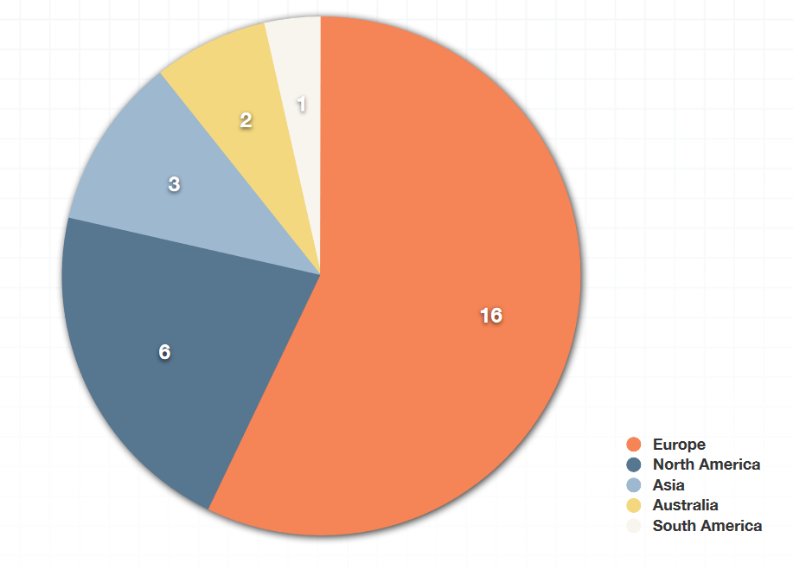
Pie Chart

Slide 57
Pie Chart in Excel
https://www.excel-easy.com/examples/pie-chart.html

Slide 58
pieChart.py
# Import the required library
import pandas as pd
import numpy as np
import seaborn as sns
import matplotlib.pyplot as plt
# load the dataset
df = pd.read_csv("StatFun2_4_1.csv")
# Create a relative frequency table of location
df_loc = pd.DataFrame(df['location'].value_counts()/len(df))
df_loc
# Create a column "city"
df_loc['city'] = df_loc.index
df_loc
# Create a pie chart of location proportion
plt.rcParams['figure.figsize'] = (6,6)
fig = plt.figure()
ax = fig.add_subplot(1, 1, 1)
ax.pie(df_loc['location'], labels=df_loc['city'], autopct="%1.1f%%")
plt.show()

Slide 59
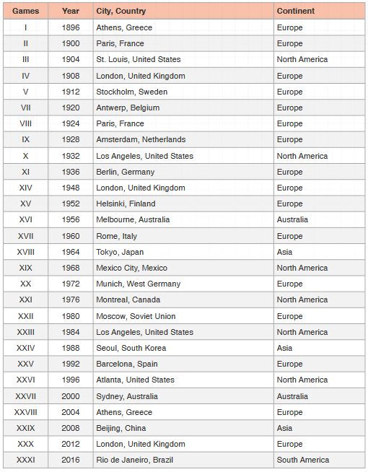
Constructing a Bar Chart: Dataset

Slide 60
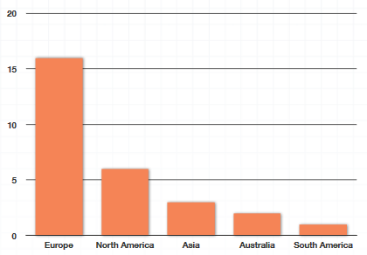
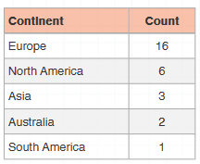
Summary Table (Frequency Table) and Bar Graph

Slide 61
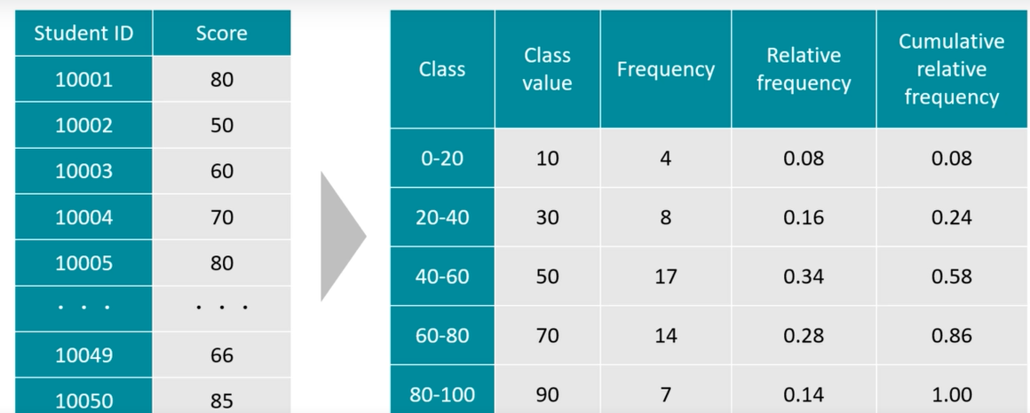
Creating a Frequency Table in Python

Slide 62
Frequency Table in Excel
https://www.excel-easy.com/examples/frequency-distribution.html

Slide 63
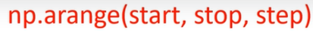
frequencyTable.py (pip install pandas and pip install numpy first)
# Import libraries
import pandas as pd
import numpy as np
# Load the data
df = pd.read_csv("StatFun2_1_1.csv")
def Frequency_Table(data, class_width):
bins = np.arange(0, data.max() + 1 + class_width, class_width)
freq = np.histogram(data, bins)[0]
cumsum = freq.cumsum()
return pd.DataFrame({'Class value': (bins[1:] + bins[:-1]) / 2,
'Frequency': freq,
'Relative frequency': freq / len(data),
'Cumulative Relative frequency': cumsum / len(data)},
index=pd.Index([f'{bins[i]}-{bins[i+1]}'
for i in range(freq.size)],
name='Class'))
print (Frequency_Table(df['exam_score'], 20))
The arange function in numpy returns an empty array
Needs 3 arguments:
Here, start of the interval is 0, stop should be last value + 1 – e.g. if we want to stop at 15, we should specify stop as 16
The histogram function returns a list of frequencies – Needs dataset as the first argument and class name as the second one
Function cumsum returns cumulative sums
Then we use the Pandas dataFrame method:
First parameter is the central value of the class
Second column is frequency
Third column is relative frequency, which can be calculated by dividing the frequency by its total number of observations
Fourth column is cumulative relative frequency

Slide 64
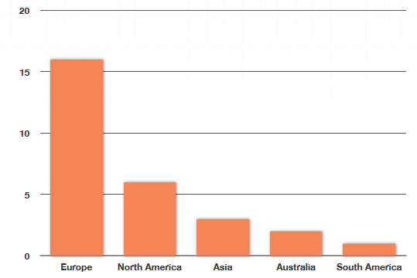
Line Graphs
Line graphs are really similar to bar graphs.
In fact, to turn a bar graph into a line graph, all we have to do is connect the middle of the top of each bar to the middle of the top of the bar beside it with a straight line, and we’ll form the line graph.
Problem: Convert our previous bar graph into a line graph:

Slide 65
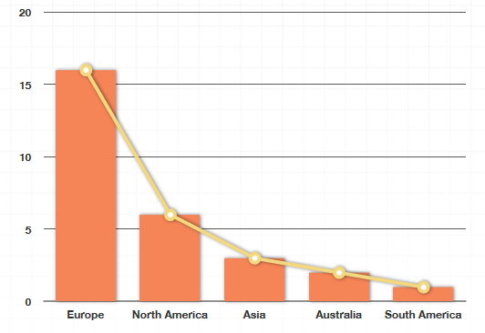
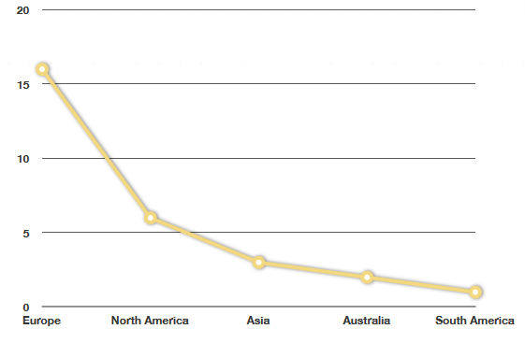
Line Graphs
Step 1 Step 2

Slide 66
Line Graph Usage
While this example is helpful for illustrating how we can transition from a bar graph to a line graph, and how the two graph types are related a line graph is a bad choice for this data.
Line graphs are used to show changes over time or a connection between individuals, but this data is comparing things between different groups.
That means the bar graph is a better choice than a line graph for this data.
Let’s look at an example with data that’s much better suited for a line graph, like the monthly average high temperature in Scottsdale, Arizona over the course of a year.

Slide 67
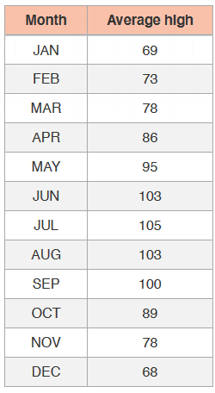
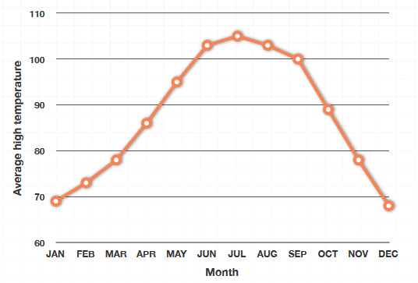
Suitable Example for Line Graph

Slide 68
Observations
Notice that the slope of each line segment gives us an idea of how much change occurred between two data points.
For example, there’s a much larger change in average high temperature between September and October than there is between August and September, because the slope of the line connecting September to October is much steeper, indicating a larger decrease in temperature, than the slope of the line connecting August to September, which is much flatter, and therefore indicates a smaller decrease in temperature.
A line graph is a fantastic way to display this kind of data, mostly because it shows clearly how a data point changes over time. We inherently understand that average high temperature fluctuates over the course of a year, with the highest temperatures usually occurring in the summer months, and the lowest temperatures usually occurring the winter months.

Slide 69
Line Graph in Excel
https://www.excel-easy.com/examples/line-chart.html

Slide 70
lineGraph.py
# Import libraries
import pandas as pd
import seaborn as sns
import matplotlib.pyplot as plt
# Load the dataset
df = pd.read_csv("StatFun2_2_2.csv")
# Create and display a line plot
sns.lineplot(x="date", y="price", data=df)
plt.gcf().autofmt_xdate()
plt.show()

Slide 71
Two-way Tables

Slide 72
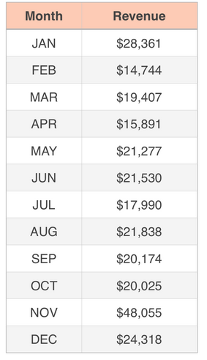
Basic Idea
In One-way Tables, we have one independent variable and one dependent variable

Slide 73
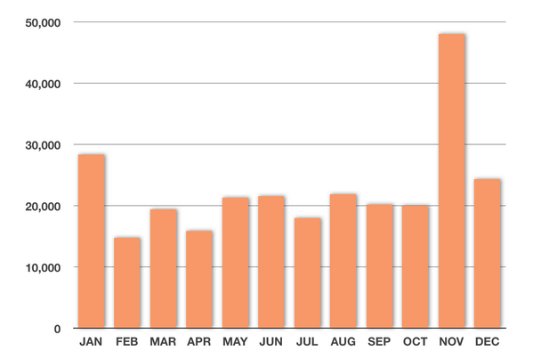
Visualizing the Data
The revenue (dependent variable) depends only on one independent variable (month). We can draw a bar graph:

Slide 74
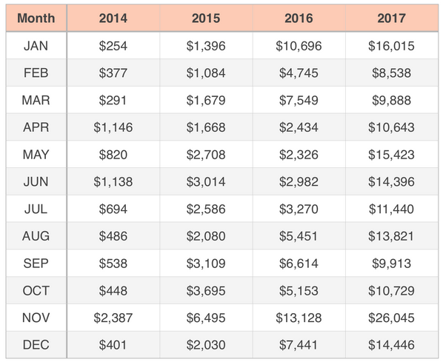
Two-way Tables
To get a better idea, we can break down the revenue information and show it for each year separately:

Slide 75
Two-way Tables
Now the data in the two-way table is now dependent on two independent things, not just one.
In the one-way table, if someone asked us how much revenue the artist earned, we’d reply “For which month?”
But in the two-way table, if someone asked us how much revenue the artist earned, we’d reply “For which year and for which month?”
In the two-way table, each value depends on two things: the month and the year.
Whereas in the one-way table, each value depended on only on thing: the month.

Slide 76
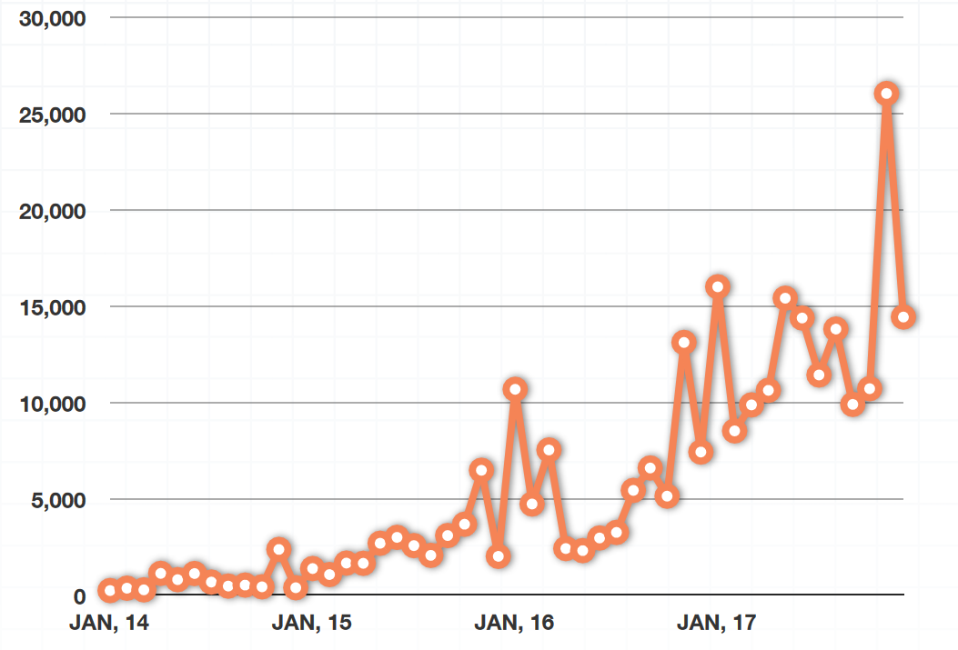
Line Graph for a part of the Data

Slide 77
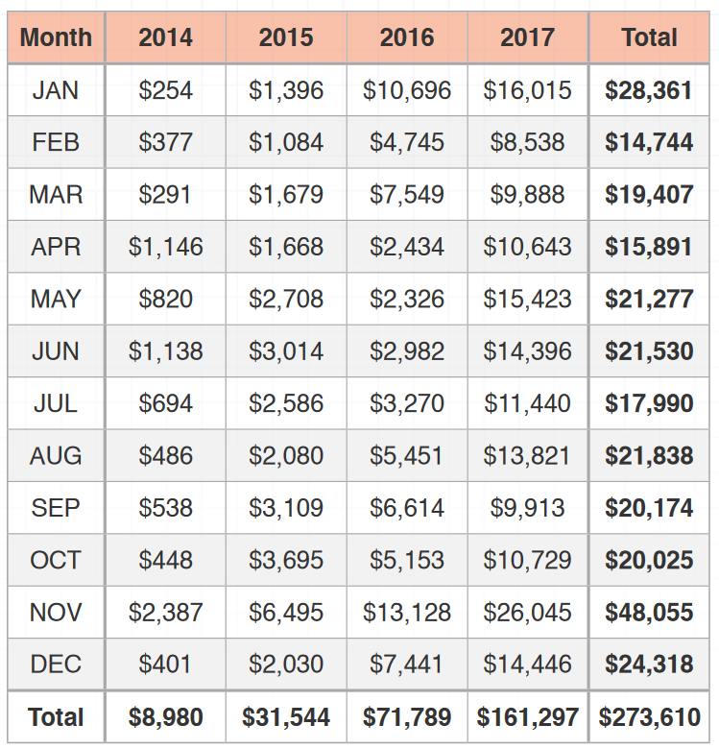
Showing Totals
In two-way tables, we can also summarize the data by row and by column, plus give a total for the entire table in the lower right-hand corner.

Slide 78
Why Totals?
From the two-way table, we can now see the revenue totals for each month down the right side of the table (these match the totals in the one-way table), but we can also see the revenue totals for each year along the bottom.
We can still see which month is best for the artist (November), but we can also see which year was best for the artist (2017).
We did a line graph to represent all of this data over time, but we could have done a bar graph, instead. (Next slide)

Slide 79
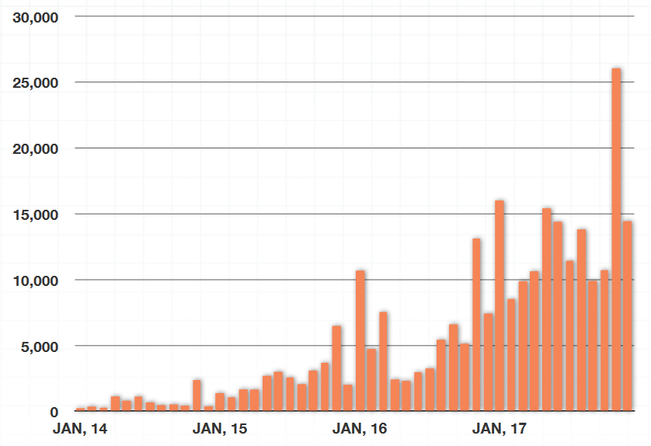
Bar Graph

Slide 80
barGraph.py
# Import the required library
import pandas as pd
import seaborn as sns
import matplotlib.pyplot as plt
# load the dataset
df = pd.read_csv("StatFun2_4_1.csv")
# Create a bar plot of gender frequency
plt.figure(figsize=(4,4))
sns.countplot(x='gender', data=df)
plt.show()
'''
# Display the same plot horizontally
plt.figure(figsize=(4,4))
sns.countplot(y='gender', data=df)
plt.show()
'''

Slide 81
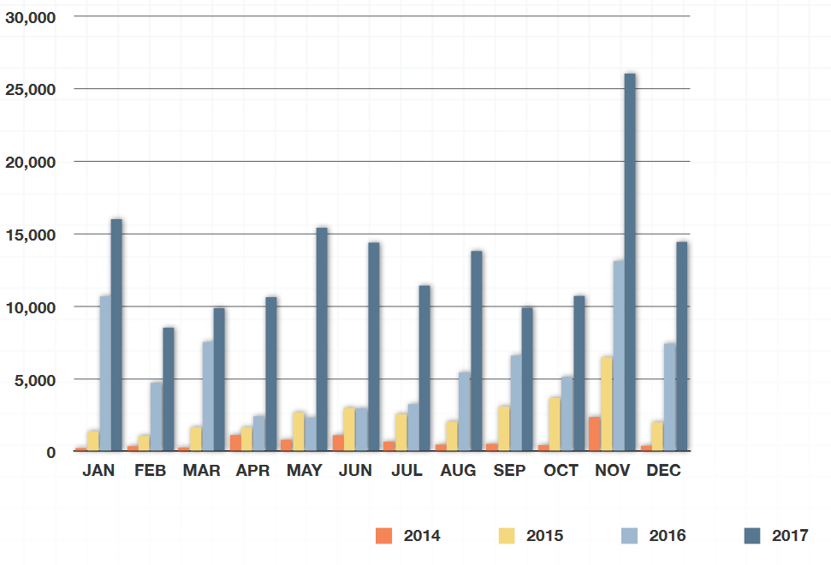
Comparison Bar Graph

Slide 82
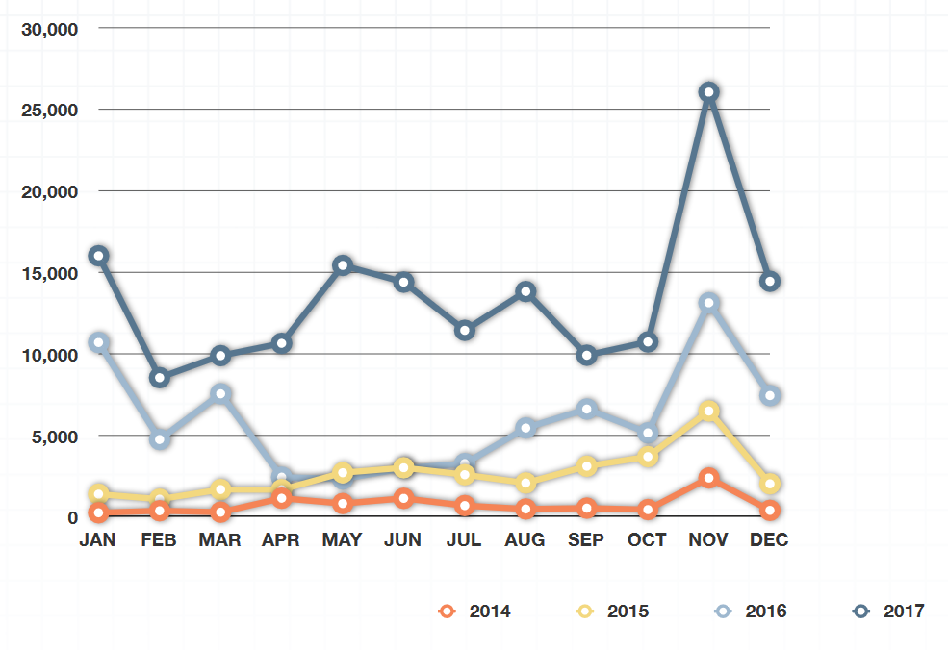
Comparison Line Graph

Slide 83
Venn Diagram
We’ve seen how we can express data in a two-way table, and then translate that data into bar and line graphs. But we can also express data from a two-way table in a different visualization called a Venn diagram.
For instance, suppose we asked students about their favorite kind of pet, and collected the following data.
2 students like dogs, but not cats or birds
3 students like cats, but not dogs or birds
1 student likes birds, but not dogs or cats
3 students like dogs and birds, but not cats
5 students like dogs and cats, but not birds
4 students like cats and birds, but not dogs
6 students like dogs, cats, and birds
7 students don’t like any kind of pet

Slide 84
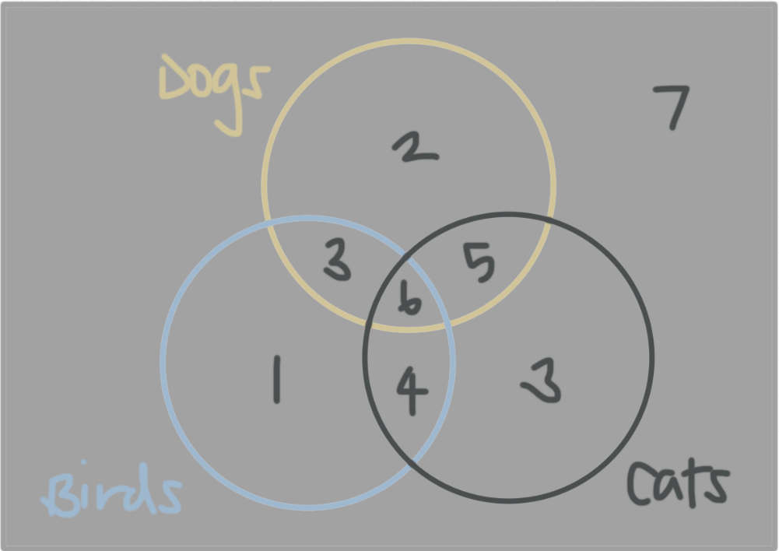
Venn Diagram

Slide 85
Interpretation
Because we put a 2 inside the brown circle but outside the black and blue circles, it means 2 students like dogs only.
Because we put a 3 inside the black circle but outside the brown and blue circles, it means 3 students like cats only.
Because we put a 1 inside the blue circle but outside the brown and black circles, it means 1 student likes birds only.
Because we put a 3 inside the overlap of the blue and brown circles but outside the black circle, it means 3 students like dogs and birds, but not cats.
...
Because we put a 7 outside all three circle circles in the corner of the Venn diagram, it means 7 students don’t like any kind of pet.

Slide 86
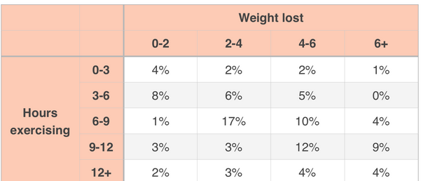
Join Distribution
It is a table of percentages that shows the distribution of one data set against the distribution of another data set.
Example: Exercise against weight loss

Slide 87
Histogram
A histogram, also called a frequency histogram, is just like a bar graph, except that we collect the data into buckets or bins, and then sketch a bar for each bucket.
Each bucket needs to be the same size, or width, so that they’re capable of holding the same amount of data.
Unlike bar charts, histograms have no gaps between the bars (although some bars might be absent, which means there’s no frequency in that “bucket”).
A histogram represents a continuous data set, which is why there are no gaps between the buckets.

Slide 88
Why Histogram?
One reason we might want to use a histogram instead of a bar graph is because we have too many data points to plot individually.
For example, maybe we want to use census data to make a graph of the number of people of each age in the entire city of San Francisco.
In a typical bar graph, we have to show a bar for children younger that 1, another for 1-year-olds, for 2-year-olds, 3, 4, 5, all the way up to 100 or maybe even older.
In other words, our bar graph might have 100 bars or more.
A histogram is the perfect solution to an overly-complicated bar graph.
To create a histogram for the same information, we might group together 0 − 9 year-olds, 10 − 19 year-olds, 20 − 29 year-olds, etc.

Slide 89
Why Histogram?
Notice that each of these buckets is the same size or length.
That’s important to remember when making a histogram.
Putting people of similar age together in those groups would allow us to create a histogram with around 10 bars, instead of a bar graph with around 100 bars.
See next slide

Slide 90
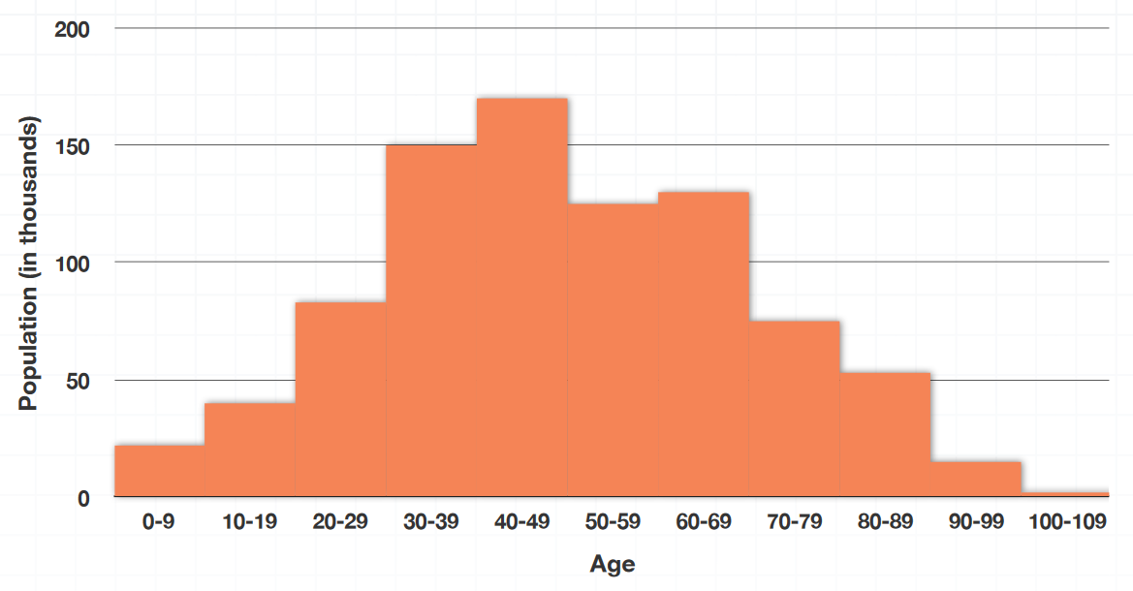
Histogram Example

Slide 91
When to use a Bar graph and when to use a Histogram?
The way the data is spread out in the histogram is called the distribution.
As a very general rule, qualitative data is usually better in a bar graph, and quantitative data is usually better in a histogram.

Slide 92
Descriptive Statistical Measures

Slide 93
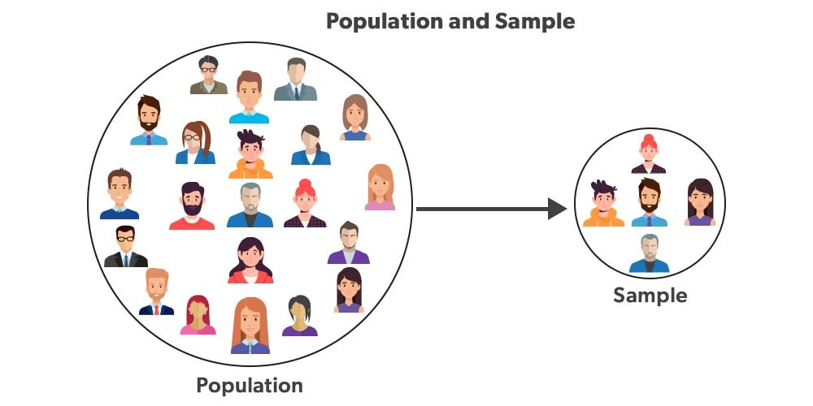
Population versus Sample

Slide 94
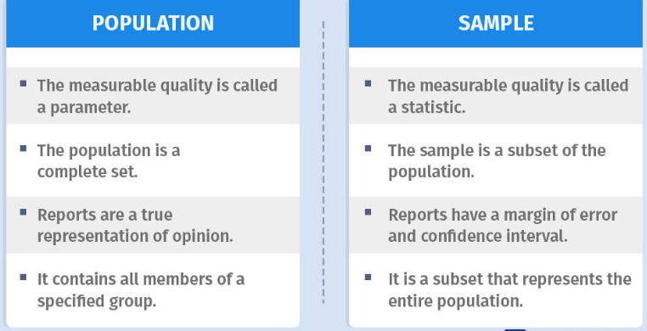
Population versus Sample

Slide 95
Measures of Location
Measures of location provide estimates of a single value that in some fashion represents the “centering” of a set of data.
The most common is the average.
We all use averages routinely in our lives, for example, to measure student accomplishment in college (e.g., grade point average), to measure the performance of sports teams (e.g., batting average), and to measure performance in business (e.g., average delivery time).

Slide 96
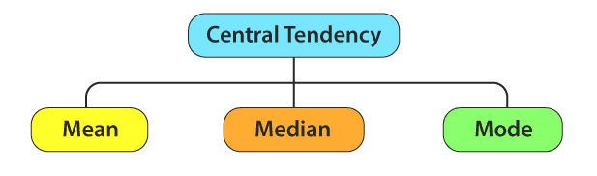
Central Tendency
The central tendency is the statistical measure that represents the single value of the entire distribution or a dataset.

Slide 97
Basic Usage
All three measures of location have their own advantages and disadvantages, and the choice of which one to use depends on the nature of the data and the research question being investigated
Mean is preferred when the data is normally distributed and there are no outliers
Median is preferred when the data is skewed or has extreme values
Mode is useful for identifying the most common value or values in a dataset, but it is not used as frequently as the mean or median

Slide 98
Mean
Mean is the average of the given numbers and is calculated by dividing the sum of given numbers by the total number of numbers
Suppose we have a dataset of five test scores: 70, 80, 90, 85, and 75. To calculate the mean, we would first add up all the scores:
70 + 80 + 90 + 85 + 75 = 400
Next, we would divide the sum by the number of scores (which in this case is 5) to get the mean:
Mean = 400 / 5 = 80
So the mean test score in this dataset is 80

Slide 99
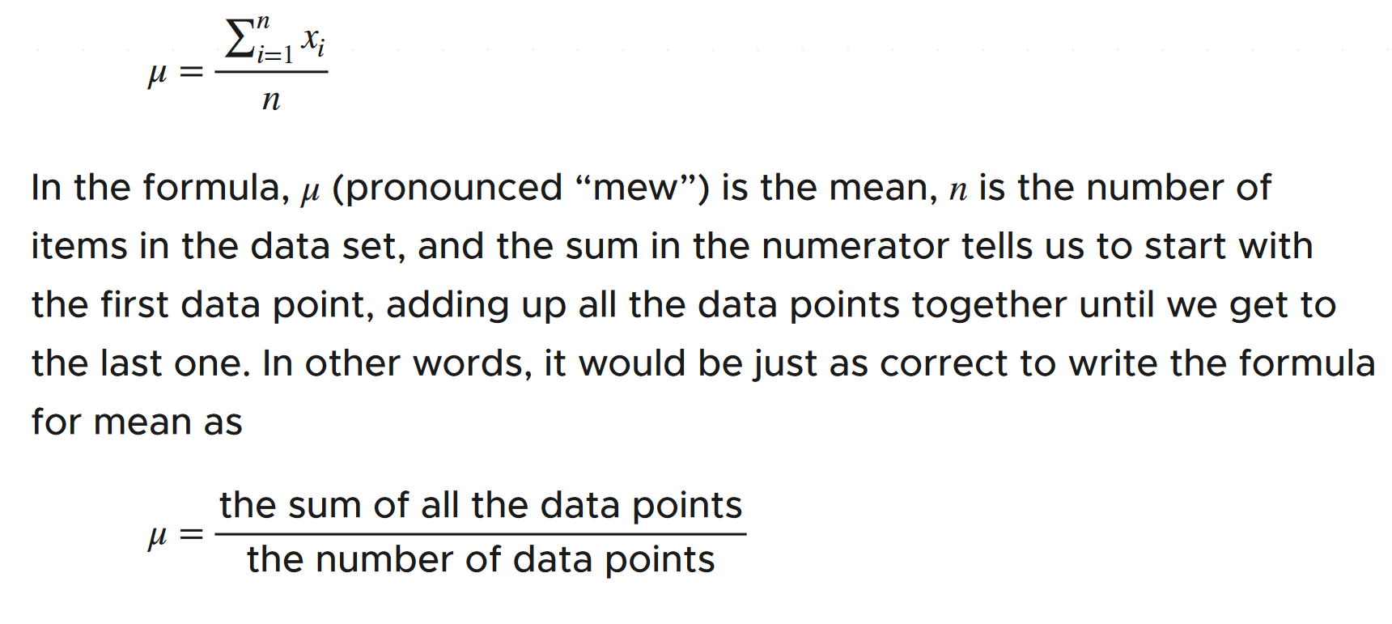
Mean Formula

Slide 100
Outliers
Extreme values can impact mean
Such values are called as outliers
Example: Marks obtained by students in an examination: 78, 67, 59, 82, 3

Slide 101
Python program for mean – Without Library
# Define a list of numbers
numbers = [70, 80, 90, 85, 75]
# Calculate the mean
mean = sum(numbers) / len(numbers)
# Print the result
print("The mean is:", mean)

Slide 102
Python program for mean – Using Library
import statistics
# Define a list of numbers
numbers = [70, 80, 90, 85, 75]
# Calculate the mean using the mean() function
mean = statistics.mean(numbers)
# Print the result
print("The mean is:", mean)

Slide 103
Mean in Excel
AVERAGE and AVERAGEA functions
Enter 56, 78, 45, 49, 55, and 62 into cells B2 through B7
Selected B8 for the result
From the Statistical Functions menu, choose AVERAGE to open the AVERAGE Function Arguments dialog box
What is AVERAGEA?
When AVERAGE calculates a mean, it ignores cells that contain text and it ignores cells that contain the expressions TRUE or FALSE
AVERAGEA takes text and expressions into consideration when it calculates a mean
If a cell has text or FALSE, it has a value of 0
If a cell holds the word TRUE, it has a value of 1
AVERAGEA includes these values in the mean
May not be needed much, but it is available if needed

Slide 104
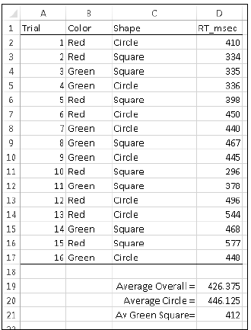
Conditional Mean in Excel
AVERAGEIF and AVERAGEIFS functions
AVERAGEIF includes numbers in the average if a particular condition is met AVERAGEIFS includes numbers in the average if more than one condition is met
Exercise: Use this data with AVERAGEIF
=AVERAGEIF(Shape,”Circle”,RT_msec)
=AVERAGEIFS(RT_msec,Color,”Green”,Shape,”Square”)

Slide 105
Mean in Excel: Dealing with Outliers
TRIMMEAN function
Enter the following values in Excel: 500, 280, 550, 540, 525, 595, 620, 1052, 591, 618
Then in the results cell, select function TRIMMEAN
It needs a second parameter: How many values to ignore in percentage terms from the top and from the bottom
We can give it as 20% and then check the result
Also check the corresponding value for just the mean

Slide 106
Median
The median represents the middle value of a dataset when the values are arranged in order
In other words, it is the value that divides the dataset into two equal halves
To find the median, we first arrange the values in the dataset in ascending or descending order
If there is an odd number of values in the dataset, the median is the middle value
If there is an even number of values in the dataset, the median is the average of the two middle values

Slide 107
Median Calculation
For example, consider the following dataset of exam scores: 62, 78, 84, 89, 91, 95, 97
To find the median of this dataset, we first arrange the scores in order:
62, 78, 84, 89, 91, 95, 97
Since there are 7 scores in the dataset, the median is the middle value, which is 89
If we had an even number of values, say: 62, 78, 84, 89, 91, 95
To find the median of this dataset, we first arrange the scores in order:
62, 78, 84, 89, 91, 95
Since there are 6 scores in the dataset, the median is the average of the two middle values, which are 84 and 89. So, the median is (84 + 89) / 2 = 86.5

Slide 108
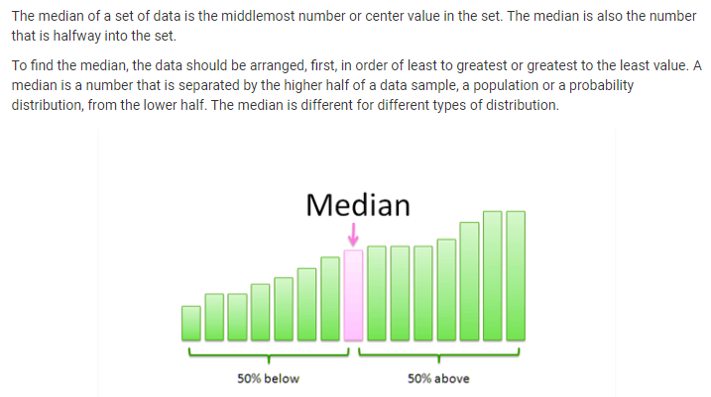
Median: Illustrated

Slide 109
Median and Outliers/Extreme Values
The median is useful when the dataset has extreme values or is skewed, as it is less sensitive to outliers than the mean
Example: Mean of 56, 78, 45, 49, 55, 62 is 57.5, but if we have one outlier with values as 56, 180, 45, 49, 55, 62 then the mean is 74.5
This is clearly misleading, since no value other than the outlier is above 74.5
But the corresponding medians will be 55.5 and again 55.5

Slide 110
Python Median – Without Library
# Define a list of numbers
numbers = [62, 78, 84, 89, 91, 95, 97]
# Sort the list of numbers in ascending order
numbers.sort()
# Calculate the median
n = len(numbers)
if n % 2 == 0:
median = (numbers[n//2 - 1] + numbers[n//2]) / 2
else:
median = numbers[n//2]
# Print the result
print("The median is:", median)

Slide 111
Python Median – Using Library
import statistics
# Define a list of numbers
numbers = [62, 78, 84, 89, 91, 95, 97]
# Calculate the median using the median() function
median = statistics.median(numbers)
# Print the result
print("The median is:", median)

Slide 112
Impact of Large Values (Outliers)
Large values impact mean, but not median, as discussed earlier
Let us a Python program that creates some hypothetical data and calculates mean and median
Let us then add a very large value to the data and recalculate these values
Note: We may not understand normal distribution etc for now, but we shall study it shortly

Slide 113
C:\code\Data Analytics\mean_median.py
# Create fake income data centered around 27,000 with a normal distribution
# and standard deviation of 15,000 with 10,000 data points.
# Then compute mean and median
import numpy as np
incomes = np.random.normal(27000, 15000, 10000)
print ("*** Before Bezos ***")
income_mean = np.mean(incomes)
print ("Mean is: {}".format(income_mean))
income_median = np.median(incomes)
print ("Median is: {}".format(income_median))
# Add Jeff Bezos to the income group - huge inequality! Outlier ...
incomes = np.append(incomes, [1000000000])
print ("*** After Bezos ***")
income_mean = np.mean(incomes)
print ("Mean is: {}".format(income_mean))
income_median = np.median(incomes)
print ("Median is: {}".format(income_median))

Slide 114
Median in Excel
Enter these values : 45, 49, 55, 56, 62, 78
Use MEDIAN function

Slide 115
Mode
The mode is a measure of central tendency in statistics that represents the value that occurs most frequently in a dataset. In other words, it is the value that has the highest frequency in the dataset.
For example, consider the following dataset of exam scores:
62, 78, 84, 89, 91, 95, 97, 89, 91, 89
To find the mode of this dataset, we first count the frequency of each value:
62: 1, 78: 1, 84: 1, 89: 3, 91: 2, 95: 1, 97: 1
In this dataset, the value 89 occurs most frequently, with a frequency of 3. Therefore, the mode of this dataset is 89.
If there are multiple values with the same highest frequency, the dataset is said to be multimodal, and there are multiple modes.

Slide 116

Bimodal, Trimodal, Multimodal data

Slide 117
Python Mode – Without Library
# Define a list of numbers
numbers = [62, 78, 84, 89, 91, 95, 97, 89, 91, 89]
# Create an empty dictionary to store the frequencies of each value
freq = {}
# Loop through the list of numbers and count the frequency of each value
for n in numbers:
if n in freq:
freq[n] += 1
else:
freq[n] = 1
# Find the value(s) with the highest frequency
mode_freq = max(freq.values())
mode = [k for k, v in freq.items() if v == mode_freq]
# Print the result
print("The mode is:", mode)

Slide 118
Python Mode – Using Library
import statistics
# Define a list of numbers
numbers = [62, 78, 84, 89, 91, 95, 97, 89, 91, 89]
# Calculate the mode using the mode() function
mode = statistics.mode(numbers)
# Print the result
print("The mode is:", mode)

Slide 119
Mode in Excel
MODE.SNGL and MODE.MULT functions
Test data: 56, 23, 77, 75, 57, 75, 91, 59, and 75
MODE.MULT function returns (potentially) an array of answers, not just one
Here, you select an array of cells for the results, and when you finish with the dialog box you press Ctrl+Shift+Enter to populate the array

Slide 120

Comparison and Relation

Slide 121
Measures of Dispersion
We looked at measures of central tendency, in which we saw were various ways of representing the “middle” of a data set.
But central tendency isn’t the only thing we’re interested in when it comes to data.
We also want to know about spread, which is how, and by how much, our data set is spread out around its center.
We also call measures of spread as measures of dispersion, or scatter.

Slide 122

Measures of Dispersion

Slide 123

Range
The range is the simplest and is the difference between the maximum value and the minimum value in the data set.
It is affected by outliers and, thus, is often only used for very small data sets.

Slide 124
Python Range
# Define a list of numbers
numbers = [62, 78, 84, 89, 91, 95, 97, 89, 91, 89]
# Calculate the range
range_of_numbers = max(numbers) - min(numbers)
# Print the result
print("The range is:", range_of_numbers)

Slide 125

Python Range Function
Do not confuse Python range () function here
In Python, there is a range () function, but it returns a sequence of numbers in the range

Slide 126
Problems with Range
The range can sometimes be misleading when there are extremely high or low values.
Example: In {8, 11, 5, 9, 7, 6, 2500}:
The lowest value is 5, and the highest is 2500
So the range is 2500 − 5 = 2495
In such a case, we may use Interquartile Range

Slide 127
Interquartile Range (IQR)
When you divide something into four parts, you cut it in half and then cut each half in half again.
Each of those pieces is then a quarter of the original whole.
In a similar way, we can divide a data set into quarters by using the medians in the data.
We cut the data in half at the median, and then find the median of each half, splitting the data at those points.
Each quarter of the data that we’ve created is bounded by the data’s quartiles.
The median of the lower half of the data is called the first quartile Q1, the median of the upper half of the data set is called the third quartile Q3, and the median of the entire data set is the second quartile Q2.
The interquartile range is the difference between the median of the upper half and the median of the lower half, or Q3 − Q1.

Slide 128
Interquartile Range – Example
Suppose following are scores from some sport:
66, 67, 67, 68, 68, 68, 68, 69, 69, 69, 69, 70, 70, 71, 71, 72, 73, 75
The median is (69 + 69)/2 = 69, because:
To find the IQR, we’ll now split the data in half.
Since this data set has 18 data points, we’ll have 9 data points in the lower half, and 9 data points in the upper half.
We then need to find the median of each half.

Slide 129



Interquartile Range – Example
Median of the lower half is 68
Median of the upper half is 71
Putting it together
IQR = 71 – 68 = 3

Slide 130
IQR for even and odd number of data points
Notice that in this data set of scores we had an even number of data points, and we therefore just divided the number of data points in two to get 9 data points in the lower half and 9 data points in the upper half.
We also need to know how to calculate the IQR when we have an odd number of data points.

Slide 131
IQR for odd number of data points
Consider a data set with 11 data points
66, 67, 68, 69, 69, 69, 70, 71, 71, 72, 75
If we find the median, we can see that it’s 69.
To separate the data into two halves with an equal number of data points in each, we’ll take the lower half as everything below the median (not including the median), and the upper half as everything above the median (not including the median).
So the lower half will be 66, 67, 68, 69, 69, and its median is 68.
The upper half will be 70, 71, 71, 72, 75 and its median is 71.
The IQR of this data set with an odd number of data points is therefore 71 − 68 = 3.

Slide 132
Interquartile Range in Python
import numpy as np
# Define a list of numbers
numbers = [62, 78, 84, 89, 91, 95, 97, 89, 91, 89]
# Calculate the IQR using the percentile() function from numpy
q1, q3 = np.percentile(numbers, [25, 75])
iqr = q3 - q1
# Print the result
print("The interquartile range is:", iqr)

Slide 133
Interquartile Range using Library
from scipy.stats import iqr
# Define a list of numbers
numbers = [62, 78, 84, 89, 91, 95, 97, 89, 91, 89]
# Calculate the IQR using the iqr() function from scipy.stats
iqr_of_numbers = iqr(numbers)
# Print the result
print("The interquartile range is:", iqr_of_numbers)

Slide 134
Variance
Variance is a measure of how far a set of data (numbers) are spread out from their mean (average) value
It is calculated by taking the average of the squared differences of each data point from the mean
The more the value of variance, the data is more scattered from its mean and if the value of variance is low or minimum, then it is less scattered from mean
Therefore, it is called a measure of spread of data from mean

Slide 135
Variance Calculation
Find the mean of the given data set.
Subtract the mean from each value and square them.
Find the average of these squared values, that will result in variance.

Slide 136
Variance Example
Consider data values 5, 7, 10, 12, and 15
Step 1: Find the mean: To find the mean, add up all the numbers in the set and divide by the total number of numbers: (5 + 7 + 10 + 12 + 15) / 5 = 9.8
Step 2: Find the squared differences from the mean: Subtract the mean from each number in the set and square the result

Slide 137
Variance Example
Step 2: Find the squared differences from the mean: Subtract the mean from each number in the set and square the result
(5 - 9.8)^2 = 20.24
(7 - 9.8)^2 = 6.76
(10 - 9.8)^2 = 0.04
(12 - 9.8)^2 = 5.44
(15 - 9.8)^2 = 27.04

Slide 138
Variance Example
Step 3: Find the average of the squared differences: Add up the squared differences and divide by the total number of numbers
(20.24 + 6.76 + 0.04 + 5.44 + 27.04) / 5 = 11.12
So, the variance of the set is 11.12
This means that the numbers in the set are, on average, about 11.12 units away from the mean
A larger variance indicates a greater spread of the data, while a smaller variance indicates that the data points are closer together

Slide 139
Why are the Differences Squared?
We see that differences between data points and the mean are squared
Reason: If we do not do this, then the positive and negative differences may cancel each other and we may not be able to find how the data points are dispersed from the mean
Example: Consider marks of 5 students
55, 60, 65, 54, 64
Mean: 59.6
Variance: 20.24
But if we do not square the differences, what will happen?

Slide 140
“Variance” without Squaring the Differences
Impact: Negative and positive differences of the data points with reference to the mean cancel each other, and their average becomes 0
But when we square them the cancellation effect goes and we get proper variance
Marks | Marks - Mean | (Marks - Mean) Squared
55 | -4.6 | 21.16
60 | 0.4 | 0.16
65 | 5.4 | 29.16
54 | -5.6 | 31.36
64 | 4.4 | 19.36
Mean | (Marks - Mean) / 5 | ((Marks - Mean) Squared)) / 5
59.6 | 0.00 | 20.24
Variance

Slide 141
Limitation of Variance: How to Quantify?
Quantifying/measuring variance is tough
Example: Consider marks of 10 students:
32, 39, 44, 56, 56, 63, 71, 72, 81, 89
Average/mean will be 60.3
Variance will be 306.81
We can just see that the variance seems to be high, but it does not convey any meaningful information beyond this
This is a limitation of variance

Slide 142
Variance in Python
data = [5, 7, 10, 12, 15]
# calculate the mean
mean = sum(data) / len(data)
# calculate the squared differences from the mean
squared_diff = [(i - mean) ** 2 for i in data]
# calculate the variance
variance = sum(squared_diff) / len(data)
print(variance)

Slide 143
Variance in Python using Library
# Python code to demonstrate the working of
# variance() function of Statistics Module
# Importing Statistics module
import statistics
# Creating a sample of data
sample = [2.74, 1.23, 2.63, 2.22, 3, 1.98]
# Prints variance of the sample set
# Function will automatically calculate
# it's mean and set it as xbar
print("Variance of sample set is % s"
%(statistics.variance(sample)))

Slide 144
Another Technique
import numpy as np
data = [5, 7, 10, 12, 15]
# calculate the variance using NumPy's var() function
variance = np.var(data)
print(variance)

Slide 145
Variance in Excel
VAR.P and VAR.S functions (Population versus Sample)
Enter values 50, 47, 52, 46, and 45
Calculate variance

Slide 146
Standard Deviation
The square root of variance is standard deviation
To calculate standard deviation, we can first compute the variance of the data and calculate its square root to get the standard deviation
Key point:
In variance calculation, we square the difference between each data point and the mean so that the sign of the difference becomes positive, even if it was negative
Also, it amplifies the outliers much more because of the squaring
In other words, we are only interested in the magnitude of the difference, not its sign – but because of the squaring, variance becomes too large and the outliers also get much more amplified
Standard deviation brings the difference back to the original scale, as it is the square root of the variance

Slide 147
Standard Deviation Example
Example: Calculate the standard deviation of 2, 1, 3, 2, and 4.
Step 1: Calculate the mean: 2 + 1 + 3 + 2 + 4 = 12 / 5 = 2.4
Step 2: Subtract mean from each value: (2-2.4), (1-2.4), (3-2.4), (2-2.4), (4-2.4) = -.04, -1.4, 0.6, -0.4, 1.6
Step 3: Square each of the differences: -0.16, 1.96, 0.36, 0.16, 2.56
Step 4: Calculate their average to get the variance: (-0.16 + 1.96 + 0.36 + 0.16 + 2.56) / 5 = 5.2 / 5 = 1.04
Step 5: Calculate square root of the variance: Square root of 1.04 = 1.01 = Standard deviation

Slide 148

Variance (Deviation) and Standard Deviation: Example

Slide 149
Problem
A class of students took a math test. Their teacher wants to know whether most students are performing at the same level, or if there is a high standard deviation.
The scores for the test were 85, 86, 100, 76, 81, 93, 84, 99, 71, 69, 93, 85, 81, 87, and 89.

Slide 150
Solution
Mean = 85.2
Variance = 75.6
Standard deviation = 8.7
Conclusion: Since the standard deviation is low, the students are performing around the same level

Slide 151


In Excel

Slide 152
Key points
High standard deviation means the average data point is far away from the mean. That is, the data is fairly spread out from the mean.
Low standard deviation means the average data point is relatively close to the mean. That is, the data is not spread out too far from the mean.
Zero standard deviation means that every data point is the same (there is no variability). This case is rare, but it is possible.

Slide 153
Standard Deviation Interpretation
Two groups could have the same mean cholesterol level, but have vastly different standard deviations. This could be due to lifestyle factors of participants in a trial:
Group A might be made up of people in reasonably good shape – they are not elite athletes, but they are not couch potatoes either. Their mean total cholesterol might be 180 mg/dL, and the standard deviation might be 10 mg/dL.
Group B might have a more diverse group of people: some of whom take great care of themselves, and others who do not. Although their mean total cholesterol might also be 180 mg/dL, the standard deviation might be 40 mg/dL.
Due to the low standard deviation, the people in group A are in relatively the same shape (as far as cholesterol goes). The high standard deviation of group B tells us that the healthy and unhealthy people in that group have a much bigger difference in their cholesterol levels.

Slide 154
Problem
A market researcher is analyzing the results of a recent customer survey that ranks a product from 1 to 10. He wants to have some measure of the reliability of the answers received in the survey in order to predict how a larger group of people might answer the same questions.
The scores for the survey are 9, 7, 10, 8, 9, 7, 8, and 9.

Slide 155
Solution
Mean: 8.4
Variance: 1.12
Standard deviation: 1.06
Conclusion: The standard deviation is 1.06, which is somewhat low. The researcher now knows that the results of the sample size are probably reliable.

Slide 156
Python Standard Deviation
data = [5, 7, 10, 12, 15]
# calculate the mean
mean = sum(data) / len(data)
# calculate the squared differences from the mean
squared_diff = [(i - mean) ** 2 for i in data]
# calculate the variance
variance = sum(squared_diff) / len(data)
# calculate the standard deviation
std_dev = variance ** 0.5
print(std_dev)

Slide 157
Python Standard Deviation using numpy
import numpy as np
data = [5, 7, 10, 12, 15]
# calculate the standard deviation using NumPy's std() function
std_dev = np.std(data)
print(std_dev)

Slide 158
Standard Deviation in Excel
STDEV.P and STDEV.S functions
Enter values 50, 47, 52, 46, and 45

Slide 159
Coefficient of Variation – 1
The coefficient of variation (CV) is a statistical measure that represents the ratio of the standard deviation to the mean of a set of data
It is expressed as a percentage and is often used to compare the variability of different data sets with different means
Formula: CV = (standard deviation / mean) x 100%

Slide 160

Example
A pizza restaurant measures its delivery time in minutes. The mean delivery time is 20 minutes and the standard deviation is 5 minutes.
In this example, the standard deviation is 25% the size of the mean.
If the value equals one or 100%, the standard deviation equals the mean.
Values less than one indicate that the standard deviation is smaller than the mean (typical), while values greater than one occur when the S.D. is greater than the mean.
In general, higher values represent a greater degree of relative variability.
That information is very useful! It tells us the variability in our data using the original measurement units. We can compare this delivery time variability to another pizza restaurant.

Slide 161
Example
A second pizza restaurant has a mean delivery time of 15 minutes and the standard deviation is 10 minutes.
Calculate the coefficient of variation and compare with the first one.
CV = 10 / 15 = 0.66 or 66%
What is the conclusion?

Slide 162
Coefficient of Variation
The coefficient of variation provides a relative measure of risk to return.
The smaller the coefficient of variation, the smaller the relative risk is for the return provided.
The reciprocal of the coefficient of variation, called return to risk, is often used because it is easier to interpret.
That is, if the objective is to maximize return, a higher return-to-risk ratio is often considered better.

Slide 163
Making Investment Decisions
Suppose we are considering two different investment options:
Option A has an average return of 10% with a standard deviation of 5%
Option B has an average return of 8% with a standard deviation of 3%.
We want to compare the risk-adjusted returns of these two options using the coefficient of variation.

Slide 164
Making Investment Decisions
Using the formula for coefficient of variation, we can calculate the CV for each option as follows:
For option A:
CV = (standard deviation / mean) x 100%
CV = (0.05 / 0.1) x 100%
CV = 50%
For option B:
CV = (standard deviation / mean) x 100%
CV = (0.03 / 0.08) x 100%
CV = 37.5%

Slide 165
Making Investment Decisions
Based on these calculations, we can see that option A has a higher coefficient of variation, indicating that it has more variability and is therefore riskier than option B. However, option A also has a higher average return, so it may be a more attractive option for investors who are willing to take on more risk in exchange for potentially higher returns.
It is important to note that the coefficient of variation should not be used in isolation to make investment decisions. It should be used in conjunction with other measures of risk and return, such as the Sharpe ratio, to provide a more complete picture of the risk-adjusted performance of different investment options.

Slide 166
Population and Sample, Probability Theory

Slide 167
Population
Population: Entire group or collection of individuals, items, or data points
Population parameters: Numerical values that describe a population
Example: Average marks obtained by all the students, median income of the population, Standard deviation in the blood sugar level of all the patients in a hospital
Symbols for population parameter: μ (mean), σ (standard deviation), π (proportion)

Slide 168
Sample
Sample: Subset of the population that is selected for data collection and analysis
Should be randomly selected
Sample statistics: Used to estimate population parameters (Example: Sample mean to estimate population parameter of mean)
Technique of choosing sample from the population is called sampling

Slide 169
Why Sampling?
Consider a school of 1000 students
The school itself is the population
Its characteristics such as the average height of the students are population parameters
We can measure the actual height of all 1000 students to get the exact average (parameter)
But might be easier to take a sample of 100 students and estimate the average based on their heights (statistic)

Slide 170
Univariate Sampling
Univariate sampling: Analysis of data that consists of a single variable or characteristic
Examples:
Analyzing the ages of individuals in a population
Examining the heights of a sample of students
Studying the test scores of students in a class
Useful analysis: Descriptive statistics such as mean, mode, median, variance, standard deviation
Visualize using: Histograms, box plots, summary statistics

Slide 171
Bivariate Sampling
Bivariate sampling: Analysis of data that consists of two variables or characteristics to find how they are related
Examples:
Amount of time spent studying (variable 1) and the test scores achieved (variable 2)
Education (variable 1) and the Income level (variable 2) in a population
Useful analysis and visualization: Scatterplots, correlation coefficients, regression analysis, cross-tabulations

Slide 172
Resampling
Resampling: Modifying a dataset by changing its size or composition
Two main resampling methods: Bootstrapping and Cross-validation
Bootstrapping: Generating multiple new samples (called bootstrap samples) from the original dataset by randomly selecting data points with replacement – Useful in estimating population parameters, regression analysis
Cross-validation: Dividing the dataset into a training set and a testing set, and iteratively training and evaluating the model on different combinations of these subsets – Useful in machine learning model evaluation

Slide 173
Sample Space and Events

Slide 174
Sample Space and Events
Sample space: All the possible outcomes of an experiment
Event: A subset of the sample space
Sample space (S)
Event (E)

Slide 175



Sample Spaces and Events
Rolling a die/dice is a random experiment - the actual outcome cannot be predicted.
We can assign a number to each outcome/event, called its probability, which tells us how likely that outcome will occur.
The sample space associated with a random experiment is the set of all possible outcomes.
An event is a subset of the sample space.

Slide 176
Sample Space: Examples
Question: Construct a sample space for the experiment that consists of rolling a single die. Find the events that correspond to the phrases “an even number is rolled” and “a number greater than two is rolled.”
Answer (Diagram on the next page):
Sample space S={1,2,3,4,5,6}
Event “an even number is rolled” E={2,4,6}
Event “a number greater than two is rolled” T={3,4,5,6}

Slide 177

Sample Space: Examples – Venn Diagram
Sample space S is represented by a rectangle
Outcomes are points in within the rectangle
Events are ovals that enclose the outcomes that compose them

Slide 178
Probability

Slide 179

Probability Definition
Probability: How likely it is that something will occur?
Written as a number or fraction (e.g. 0.5 or 50%)
Example:
What is the probability that it will rain today?
Sample space (S) = {R, NR}
P(NR) = 1 / 2 = 0.5 or 50%
This is our sample space

Slide 180

Probability Measurement
0 probability: 0% chance that something will occur (Impossible)
Probability of 1: 100 % chance that something will occur (Guaranteed)
Probabilities between 0.5 and 1: Something is more likely to occur than not
Probabilities between 0 and 0.5: Something is more likely not to occur.
Probability of 0.5: An equal chance of the event occurring versus not occurring

Slide 181

Example: Flipping a coin
Sample space
H T
If we flip a coin one time, there are two possible outcomes: we’ll either get heads or tails.
We want to know the probability of getting heads, and there’s only one outcome that satisfies this: heads.
Therefore, the probability of getting heads is
In other words, there’s a 50% chance that we’ll get heads when we flip a coin one time.

Slide 182
Example: Flipping a coin Twice
Sample space
HH HT TH TT
If we flip a coin twice, there are four possible outcomes: HH, HT, TH, and TT. Our sample space will be: {HH, HT, TH, TT}
Find the probability of getting both heads: 1/4 or 25%
Find the probability of getting at least one head: 3/4 or 75%

Slide 183

Example: Drawing a queen from deck of playing cards
There are 52 cards in a deck, which means there are 52 total possible outcomes
There are only 4 queens in the deck though, which means there are only 4 outcomes that meet our criteria
So the probability of drawing a queen is

Slide 184
Joint, Conditional, Marginal Probability

Slide 185
Basic Terms
Marginal probability is the probability of an event irrespective of the outcome of another variable: P(A)
Example: The probability that a card drawn is red: p(red) = 0.5
Joint probability is the probability of two events occurring simultaneously: P(A ∩ B)
Example: The probability that a card is a four and red = p(four and red) = 2/52 = 1/26
Conditional probability is the probability of one event occurring in the presence of a second event: P(A|B)
Given that you drew a spade card, what’s the probability that the second card is also a spade: P(spade|spade) = 13/52 * 12/51 ~ 0.05

Slide 186

Marginal Probability Example
Calculate the marginal probability of drawing a card from the deck that is either a Heart or a Diamond
Event A: Drawing a card that is a Heart (H)
Event B: Drawing a card that is a Diamond (D)
P(A) = 13/52 = ¼
P(B) = 13/52 = ¼
P(A or B) = P(A) + P(B) = (1/4) + (1/4) = 1/2

Slide 187

Conditional Probability
Conditional probability finds the probability of an event occurring given that another event has already occurred
$P\left(B | A\right)= \frac{P(A,B)}{P(A)}$
Example: Two tests were given to students. 60% students passed both tests, but the first one was easier: 80% students cleared it. What percentage of students who passed the first test also passed the second?
Solution: Next slide

Slide 188

Conditional Probability Example
Problem: Two tests were given to students. 60% students passed both tests, but the first one was easier: 80% students cleared it. What percentage of students who passed the first test also passed the second?
Solution: A = Passing the first test, B = Passing the second test
We want P(passing the second test|passed the first test), i.e. P(B|A)
$P\left(B | A\right)= \frac{P(A,B)}{P(A)}=$ $\frac{0.6}{0.8}=0.75 or 75\%$
75% of the students who passed the first test also passed the second

Slide 189
Conditional Probability Code Example
C:\code\Data Analytics\implementation\ConditionalProbabilityVisual.py
C:\code\Data Analytics\implementation\ConditionalProbability.py

Slide 190
Bayes’ Theorem

Slide 191

Bayes’ Theorem
Bayes’ Theorem, also known as Bayes’ Law or Bayes’ Rule, tells us the probability of an event, given prior knowledge of related events that occurred earlier.
Bayes’ Theorem is

Slide 192
Bayes Theorem Example
10% of patients entering a clinic have liver disease. 5% of patients entering a clinic are alcoholic. Out of the patients who have liver disease, 7% are alcoholics
Event A = Liver disease; So P(A) = 0.10
Event B = Alcoholic; So P(B) = 0.05
Event B|A = Patient is alcoholic, given that the patient has liver disease; So P(B|A) = 0.07
Find P(A|B), i.e. probability that the patient has liver disease, given that the patient is aloholic

Slide 193

Bayes Theorem Example
$P\left(Liver disease | Alcoholic\right)=\frac{P(Alcoholic|Liver disease) x P(Liver disease)}{P(Alcoholic)}$
i.e. $P\left(A | B\right)=\frac{P(B|A) x P(A)}{P(B)}$
$P\left(A | B\right)=\frac{0.07 x 0.1}{0.05}$
P(A|B) = 0.14
Conclusion: If the patient is an alcoholic, their chances of having liver disease is 0.14 (14%).

Slide 194
Problem
Let’s say that you are at work one day and have just finished lunch. You suddenly feel horrible and find yourself lying down.
You have a headache and sore throat, and you know that people with the flu have the same symptoms roughly 90% of the time.
Wanting to gain a little more information you roll over, grab your phone and search Google. You find a reputable article that says that only 5% of the population will get the flu in a given year. Ok. So, the probability of having the flu, in general, is only 5%.
You then spot one more statistic that says 20% of the population in a given year will have a headache and sore throat at any given time.
Do you have the flu? What should you do?

Slide 195

Solution
Let A = Flu, B = Symptoms
$P\left(A \right| B)=\frac{P\left(B\right|A) x P(A)}{P(B)}$
$P\left(Flu \right| Symptoms)=\frac{P\left(Symtoms \right|Flu) x P(Flu)}{P(Symtoms)}$
$P\left(A \right| B)=\frac{0.9 x 0.05}{0.2}$
$P\left(A \right| B)=$ 0.225 or 22.5%

Slide 196
Problem
Dangerous fires are rare (1%), Smoke is quite common due to barbecues (10%), 90% dangerous fires cause smoke
What is the probability that we have a dangerous fire when there is smoke?

Slide 197

Solution
$P\left(A \right| B)=\frac{P\left(B\right|A) x P(A)}{P(B)}$
$P\left(Fire \right| Smoke)=\frac{P\left(Smoke \right| Fire) x P(Fire)}{P(Smoke)}$
$P\left(Fire \right| Smoke)=\frac{90\% x 1\%}{10\%}$
$P\left(Fire \right| Smoke)=9\%$

Slide 198
Bayes Theorem and Naïve Bayes Classifier
Bayes' theorem describes how to update probabilities when new evidence becomes available
Naive Bayes refers to a specific machine learning algorithm, which is based on Bayes' theorem – Used to make decisions
Generally used for classification: Email spam/not, Transaction ok/fraud …
Works on features (See next slide)
Imagine a detective trying to solve a case: Which clues are important?
Similarly, Naiive Bayes asks: Which features are important?
Called Naiive because it assumes that all the features are independent

Slide 199
Features
Features provide information that a machine learning model needs to learn patterns and make predictions
Example: To decide the heart condition of a patient, features could be age, family history, eating habits, exercise, addictions, sleeping patterns, pathological parameters etc

Slide 200
Naïve Bayes Types
Gaussian Naive Bayes: Assumes that features follow a Gaussian (normal) distribution (Example: Height, Weight, etc); so less effective with categorical data
Multinomial Naive Bayes: Suitable for discrete data, often used in text classification with word frequencies
Bernoulli Naive Bayes: Designed for binary/boolean features, useful for text classification with binary attributes
Complement Naive Bayes: An adaptation that works well on imbalanced datasets
Text Classification: Commonly used for text classification tasks such as spam detection, sentiment analysis, and document categorization

Slide 201
Naïve Bayes by Randomly Generating a Dataset
C:\code\Data Analytics\implementation\ Naive_Bayes_Randomly_Generated.py

Slide 202

Naïve Bayes Example
Find whether a user buys a product by clicking an advertisement on a site, based on salary, age, and gender
Code: C:\code\Data Analytics\implementation\ Naive_Bayes_Buying_Predictor.py

Slide 203
naïve_bayes_loan_example.py
Directory: C:\code\Data Analytics
The code uses the dummy variable concept using one-hot encoding – explained on the next slide

Slide 204
Dummy Variables using One-Hot Encoding – Part 1
Consider this statement about loan purpose:
pre_df = pd.get_dummies(df,columns=['purpose'],drop_first=True)
Here, we want to one-hot encode column purpose, meaning convert this categorical column into multiple binary columns
Original After the above statement
purpose Education Housing
0 CrCard 0 0 0
1 Education 1 1 0
2 Housing 2 0 1
3 CrCard 3 0 0

Slide 205
Dummy Variables using One-Hot Encoding – Part 2
But where has the first category CrCard disappeared?
We have stated drop_first=True for this, so the first category is gone
However, we can easily find it from the resulting dataframe
Example: In row 0 and 3, Education=0 and Housing=0, so CrCard must be 1
Original After the above statement
purpose Education Housing
0 CrCard 0 0 0
1 Education 1 1 0
2 Housing 2 0 1
3 CrCard 3 0 0

Slide 206
Confusion Matrix Concept
Confusion matrix: A table used in classification tasks in machine learning and statistics to evaluate the performance of a classification model
Tells us how accurate our predictions are
The confusion matrix provides valuable insights into the model's accuracy, precision, recall, and other important metrics
Generally it is a 2x2 table

Slide 207
Confusion Matrix Components
True Positives (TP): Prediction: Positive, Actual result: Positive
True Negatives (TN): Prediction: Negative, Actual result: Negative
False Positives (FP): Prediction: Positive, Actual result: Negative; Also known as Type I error – These are false alarms
False Negatives (FN): Prediction: Negative, Actual result: Positive; Also known as Type II error
 | Predicted Positive | Predicted Negative
Actual positive | TP | FN
Actual negative | FP | TN

Slide 208
Email Example
Suppose you have a dataset with 100 emails, and your model makes predictions for each email. Here are the results:
True Positives (TP): 35 emails were correctly classified as spam
True Negatives (TN): 50 emails were correctly classified as not spam
False Positives (FP): 5 emails were incorrectly classified as spam (actually not spam)
False Negatives (FN): 10 emails were incorrectly classified as not spam (actually spam)
 | Predicted Spam (Positive) Not Spam (Negative) |  | Total
Actual Spam Actual Not Spam | 35 (TP) | 10 (FN) | 45
 | 5 (FP) | 50 (TN) | 55
Total | 40 | 60 | 100

Slide 209
Use of Confusion Matrix
Consider the following situation in a cancer clinic and prepare a confusion matrix:
9 patients have cancer and the cancer test also says they have cancer
1 patient has cancer but the cancer test says could not detect it
99 patients do not have cancer but the cancer test says they have cancer
891 patients do not have cancer and the cancer test also correctly says it

Slide 210
Interpretation
9 patients have cancer and the cancer test also says they have cancer
Cancer = True and Test result = Positive
True Positive (TP)
1 patient has cancer but the cancer test says could not detect it
Cancer = True and Test result = Negative
False Negative (FN)
99 patients do not have cancer but the cancer test says they have cancer
Cancer = False and Test result = Positive
False Positive (FP)
891 patients do not have cancer and the cancer test also correctly says it
Cancer = False and Test result = Negative
True Negative (TN)

Slide 211
Confusion Matrix for the Cancer Patients Data
 | Predicted Positive Negative |  | Total
Actual Positive Actual Negative | 9 (TP) | 1 (FN) | 10
 | 99 (FP) | 891 (TN) | 990
Total | 108 | 892 | 1,000

Slide 212

Type I and Type II Errors

Slide 213
Metrics Derived from Confusion Matrix
Accuracy: Measures the overall correctness of the model's predictions and is calculated as (TP + TN) / (TP + TN + FP + FN)
Precision (Positive Predictive Value): Measures the accuracy of positive predictions and is calculated as TP / (TP + FP)
Recall (Sensitivity or True Positive Rate): Measures the ability of the model to identify all positive instances and is calculated as TP / (TP + FN)
Specificity (True Negative Rate): Measures the ability of the model to identify all negative instances and is calculated as TN / (TN + FP)
F1 Score: It is the harmonic mean of precision and recall and provides a balance between the two metrics; and is calculated as 2 * (Precision * Recall) / (Precision + Recall)

Slide 214

Metrics for Our Example
$Accuracy$ $=\frac{TP+TN}{TP+TN+FP+FN}$ $=$ $\frac{9+891}{9+891+99+1}=\frac{900}{1000}$ $=$ 0.9 = 90%
Precision $=\frac{TP}{TP+ FP}$ $=$ $\frac{9}{9+99}=\frac{9}{108}$ $=$ 0.0833 = 8.33%
R$ecall=\frac{TP}{TP+FN}$ $=$ $\frac{9}{9+1}=\frac{9}{10}$ $=$ 0.9
S$pecificity=\frac{TN}{TN+FP}$ $=$ $\frac{891}{891 +99}=\frac{891}{990}$ $=$ 0.9 = 90%
F1 Score $=\frac{2 x (Precision x Recall)}{Precision+Recall}$ $=$ $\frac{2 x (0.0833 x 0.9)}{0.833+0.9}=$0.1515 = 15%

